Slide 1
ITS 365 Project: Phase 1
By Marcus Nunez & Hakeem Atanda

Slide 2
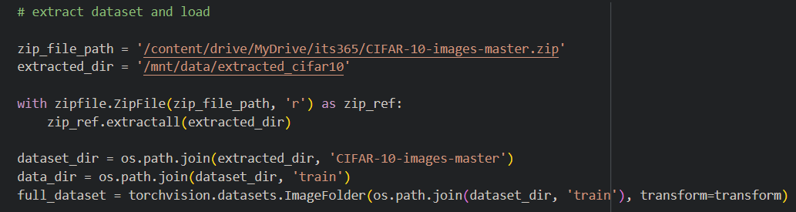
Project Goals & Input
The goal of this project is to analyze and classify the CIFAR dataset. This dataset was imported and extracted via ‘zipfile’, before being split between training and verification.

Slide 3
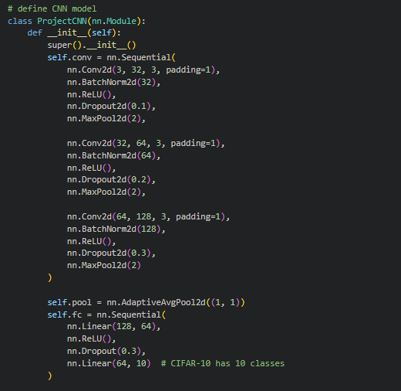
Model Classification
This model is heavily based on my previous SmileCNN, which classified whether images contained a smile or not. This utilizes a 3-layer CNN at 80% training and 20% validation. Before application, data is ran through filters of various image sizes (32, 64,128), as well as ReLU and training dropout checks.

Slide 4
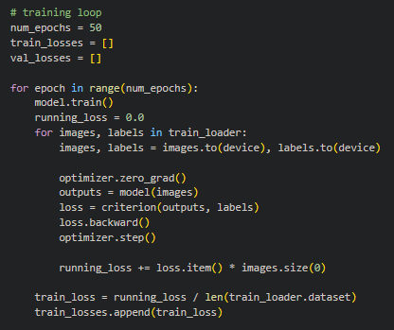
Training Method
This model trains with 50 epochs, attempting to lower the loss, each training loop ending when it it detects loss variation is less than previously.

Slide 5
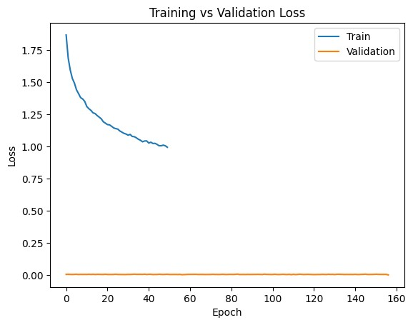
Results
Utilizing CoLab’s T4 GPU, this model was able to process in ~40 minutes, yielding favorable results. According to the graph generated through matplotlib, training was relatively effective throughout the training, loss correction gradually receding, but maintaining effectiveness.

Slide 6
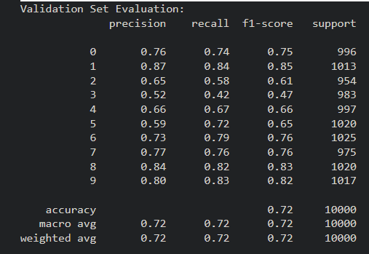
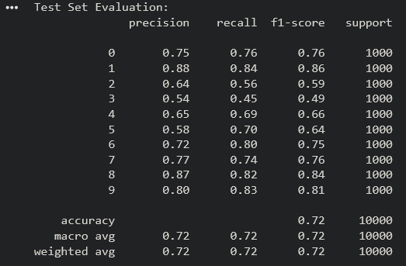
F1 Score
Classification and predictions both performed relatively the same, both achieving an F1 score of ~0.72 and an accuracy of 72%.

Slide 7
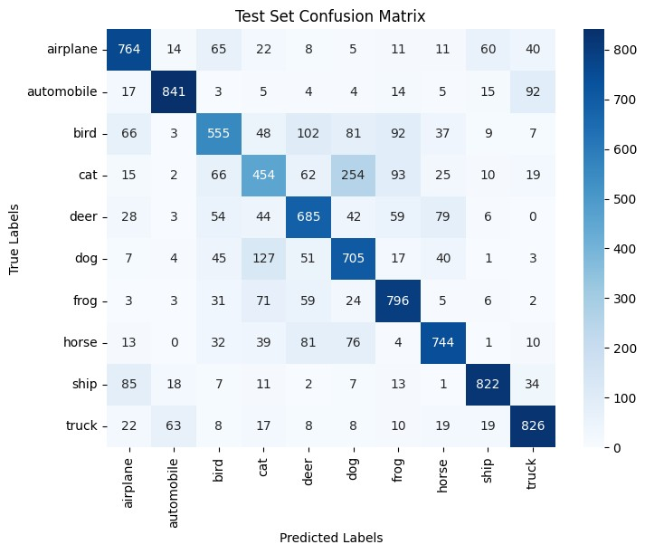
Confusion
However, each model seems to struggle with different categories, indicating that the model has a lot of cases of overlapping classes.
The confusion matrix visually details this test model’s confusion, most of which seems to be between
dogs and cats (classes 3 and 5), as well as birds being confused for deer/frogs (classes 2 and 4/6).

Slide 8
Conclusion
Overall model improvement can be focused towards these categories, testing and optimization continuing until all class confusions are lowered.

